Slide 1


Ad-Tech Platform for
Media Discovery and Planning

Slide 2
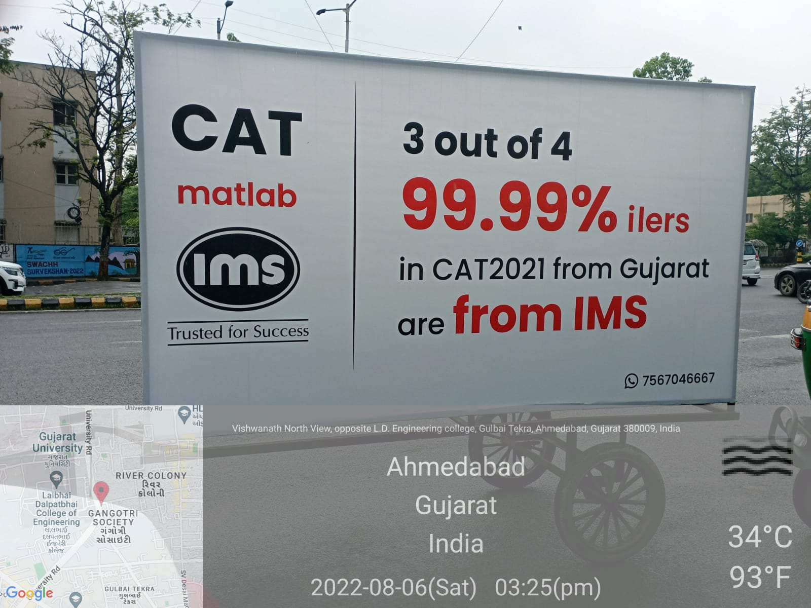
Population:
Daily Average Impression:
Dwell Time:
Traffic Cover Route:
Locality:
Station Road, state, Back Lit

Slide 3
www.excellentpublicity.com

Slide 4
THANK YOU
Let’s Build Success Together!
www.excellentpublicity.com

